Slide 1
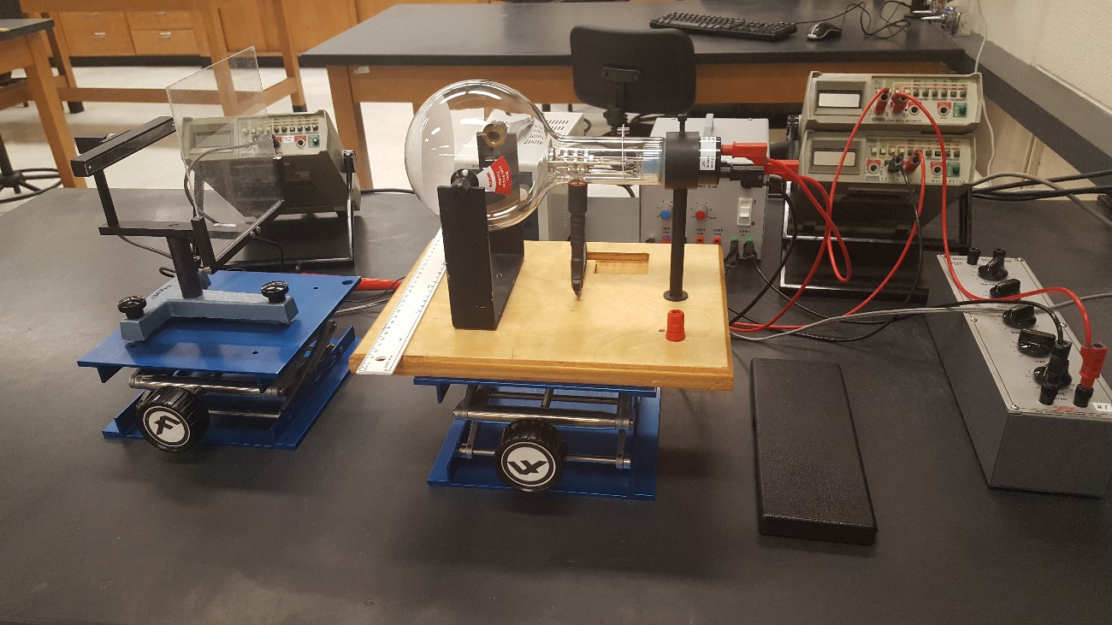
PHYS 365
Experiment 5
Electron diffraction

Slide 2
Objective
To demonstrate that electrons interact with a crystal in a manner consistent with waves rather than classical particles and produce a diffraction pattern.
To determine the lattice constants of carbon.

Slide 3
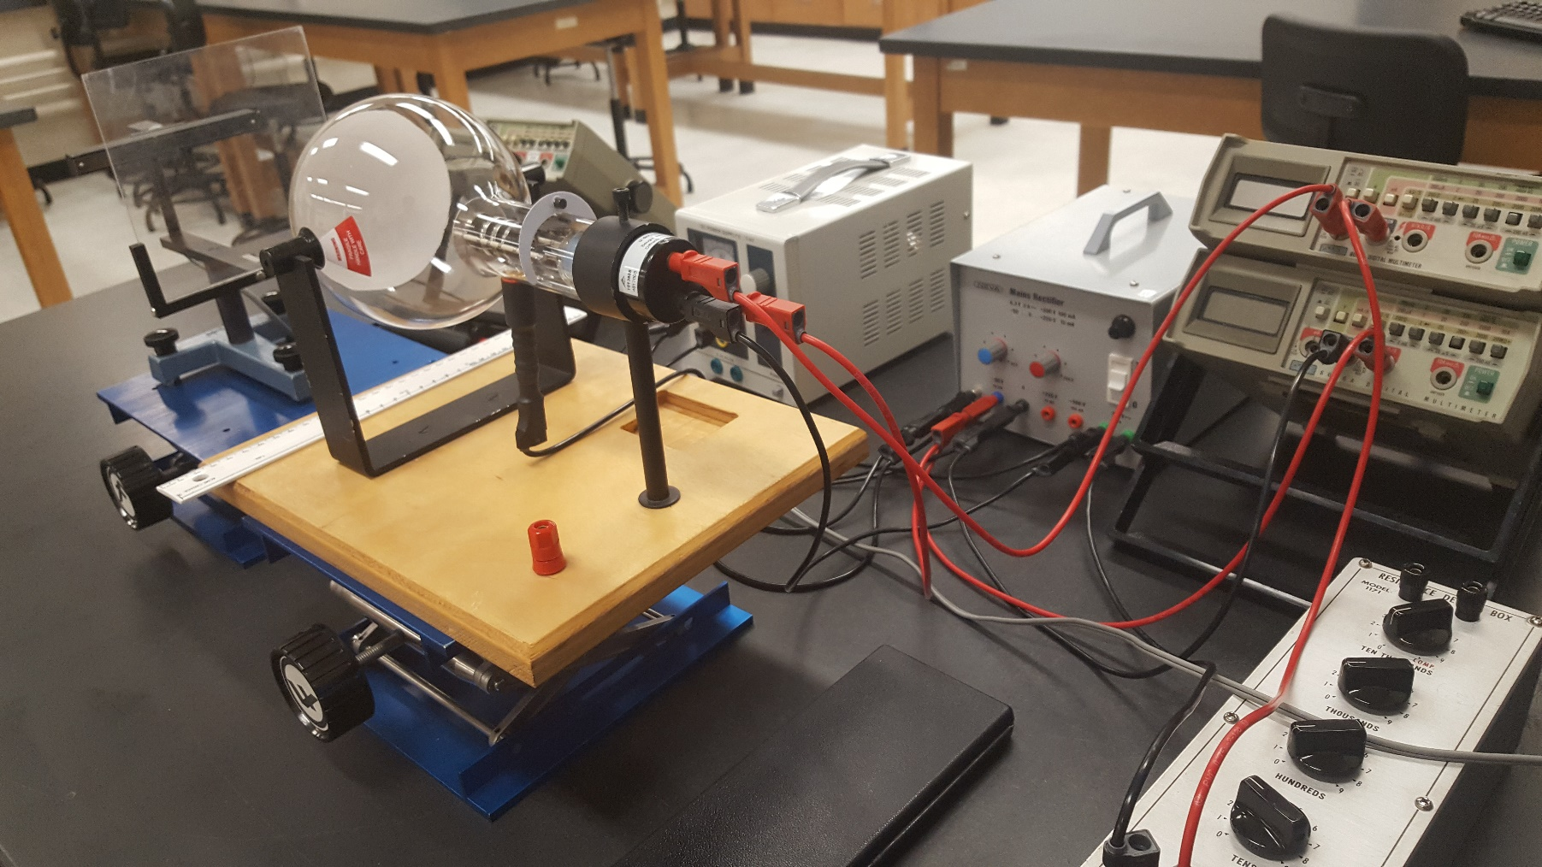
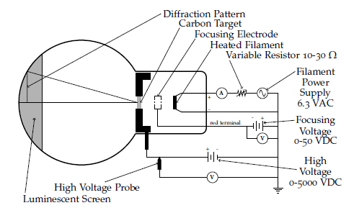
Experimental set up – delicate handle with care
You are working with the high voltage (consider safety).
Ask your TA to check your circuit before turning on the power supply.
Notes:
When observing heated filament, try to look from side to see the red or orange color.

Slide 4
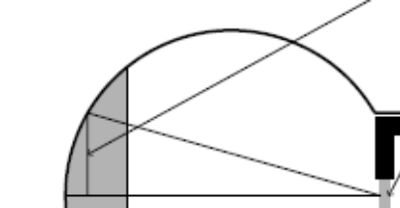
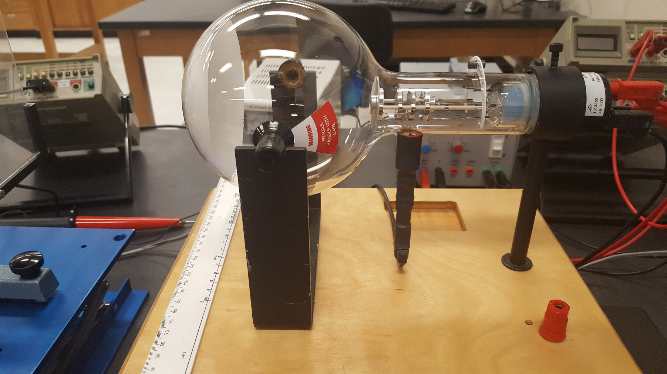
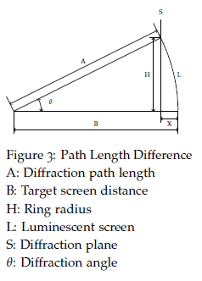
Geometry
Diffraction pattern
Accelerating potential should not be too small or too large. Otherwise it’s hard to observe the rings.
Notes:
Carbon target

Slide 5
Lab report
Use excel template from D2L to record all data and do calculations.
Upload to Dropbox
  Template.xlxs
Finish and submit before you leave.

Slide 6
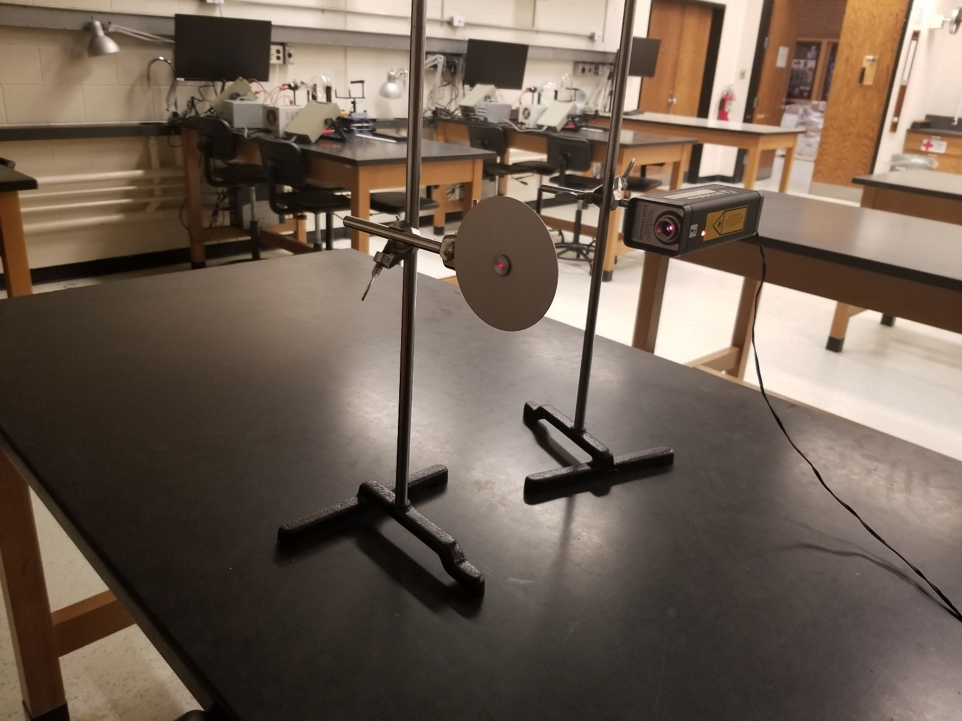
TA demonstration

